Slide 1
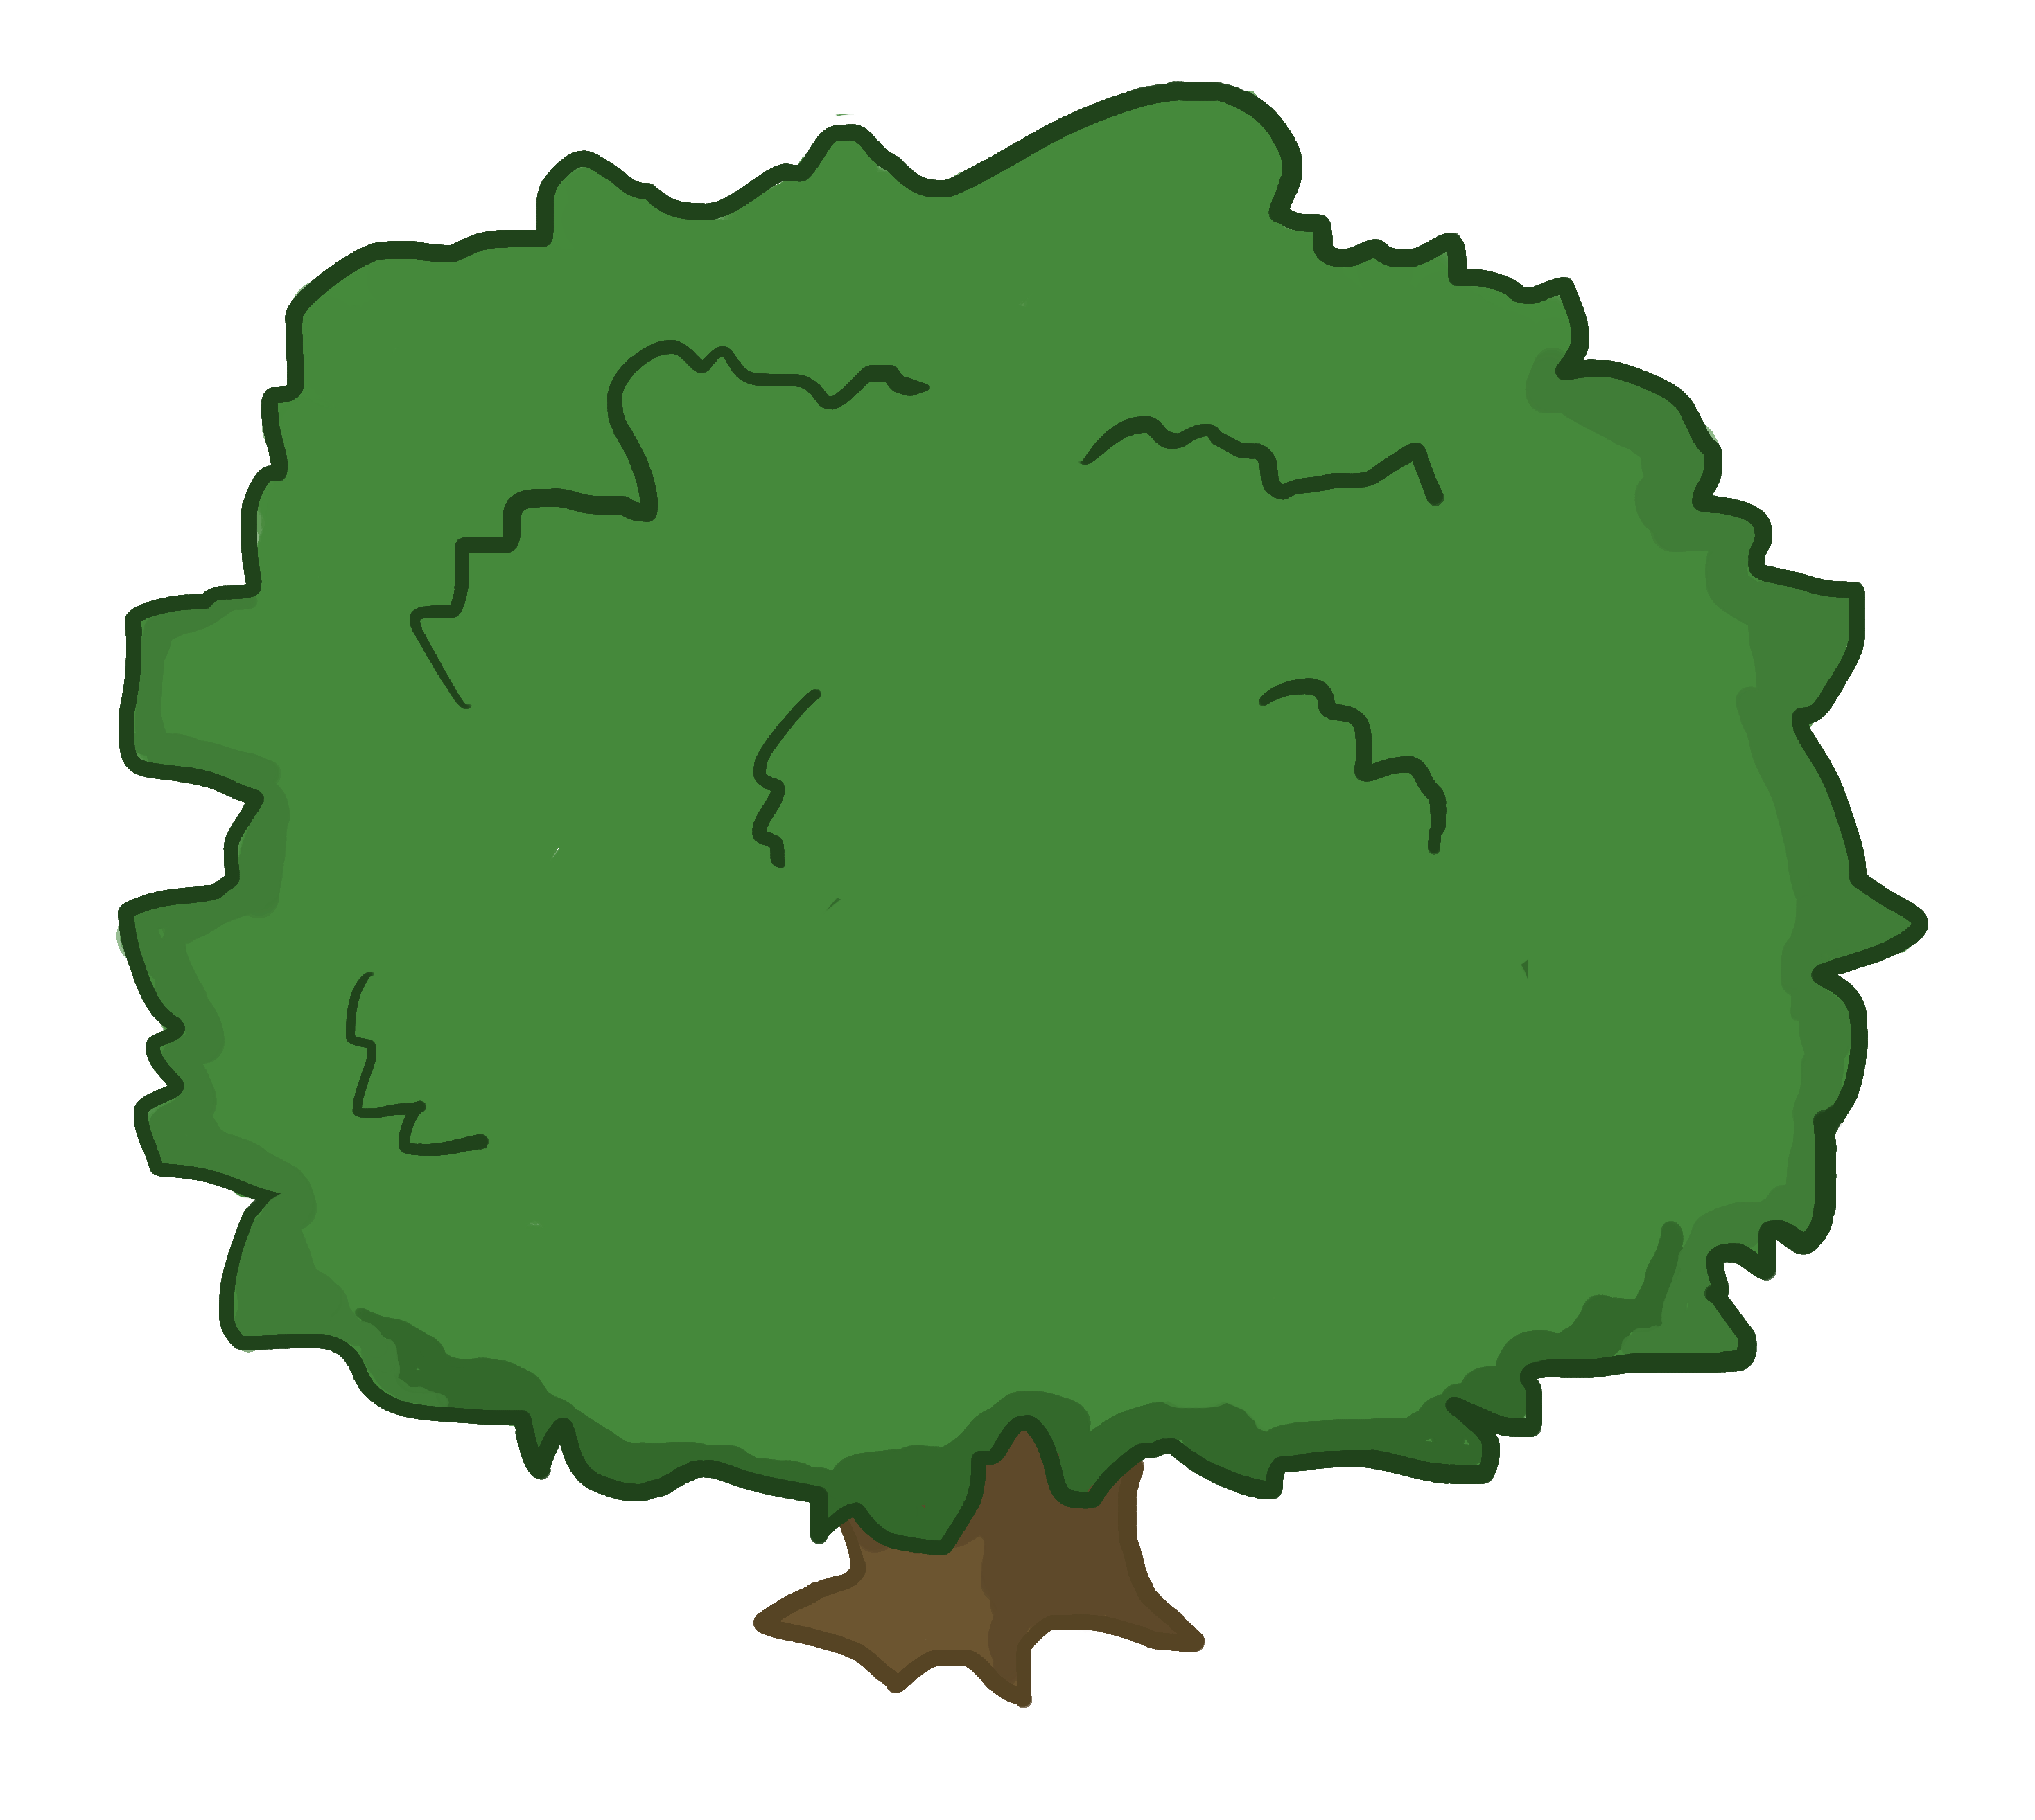
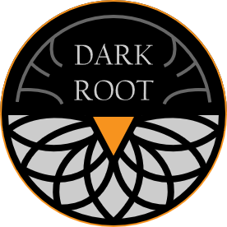
Carrot Quest The Root of Evil
STYLE GUIDE

Slide 2
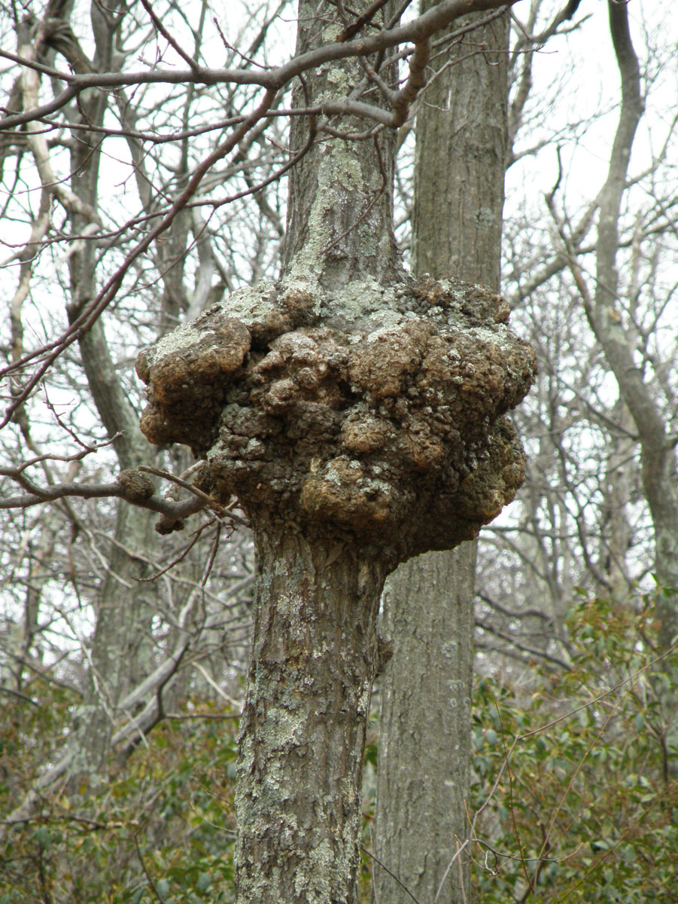
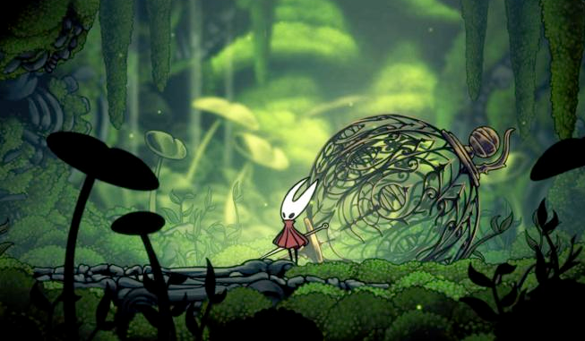
WORLD
A nature filled world with darkness and corruption lurking behind the corners. Variety of natural environments forests, grasslands, arctic, desert, catacombs, etc.
Corruption affecting the whole land, certain areas, filled to the brim with negative energy. Corruption creates unstainable growth, tumorous. Mix of decaying zombie flesh within the environment.
Hollow Knight style lineart and cell shading, enhanced with painterly elements

Slide 3
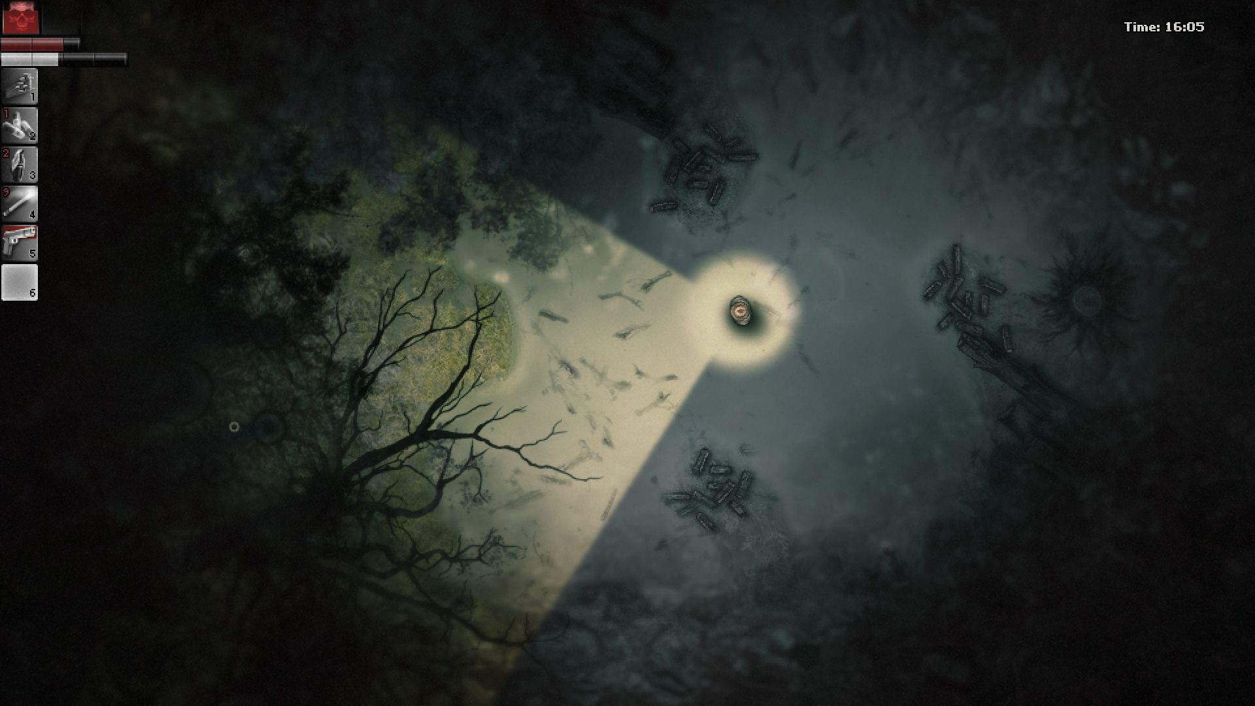
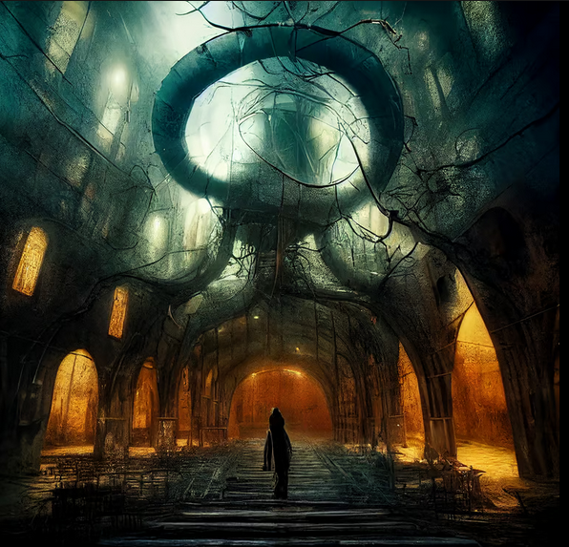
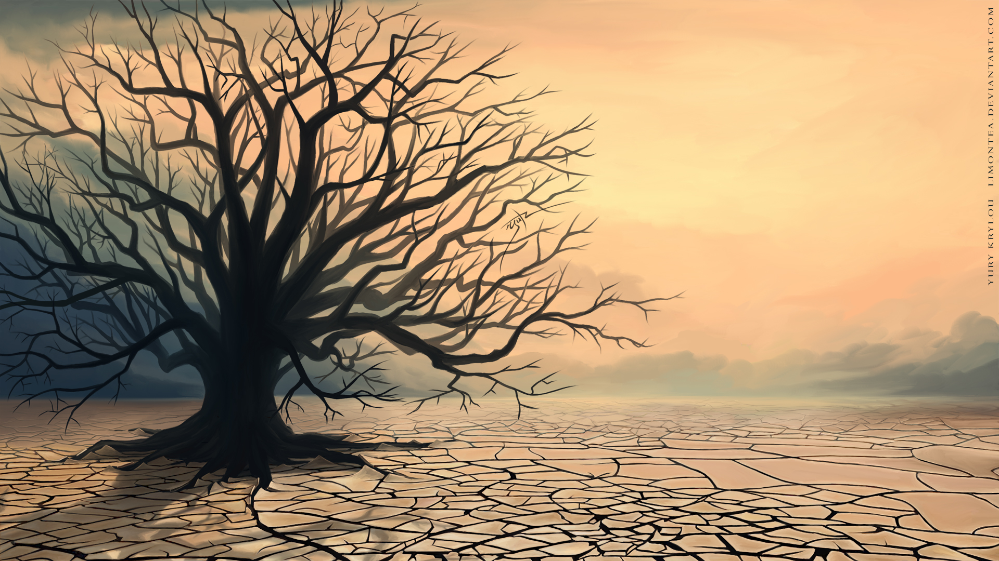
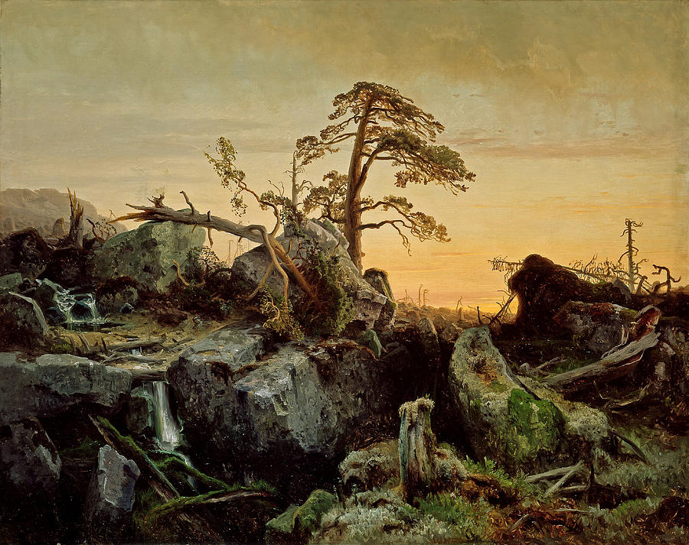
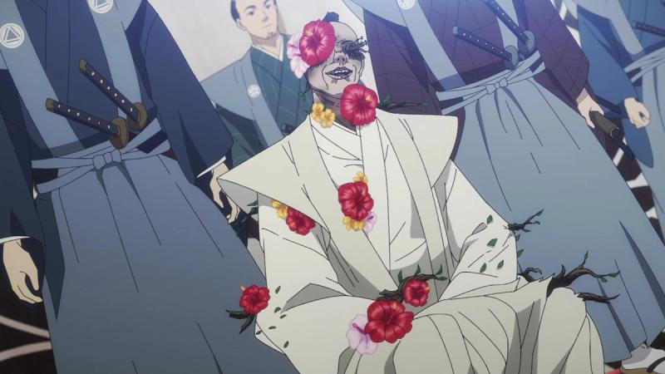
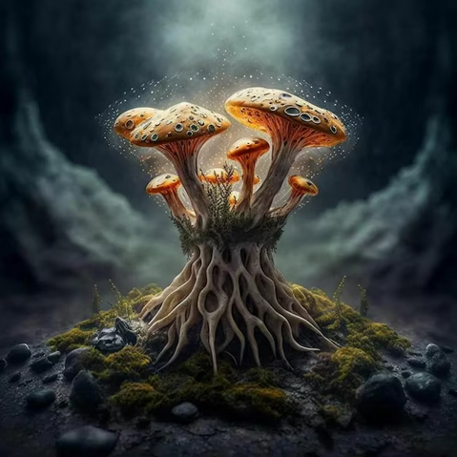
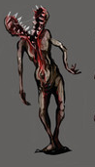
ENVIRONMENT
Reflects the natural world, with evidence of decay and corruption.
Both darkness and color coexist. A natural environment mixed with patches of decaying nature. Like a green field, that has patches of dead weeds
The beautiful elements of an environment combined with the horrific

Slide 4
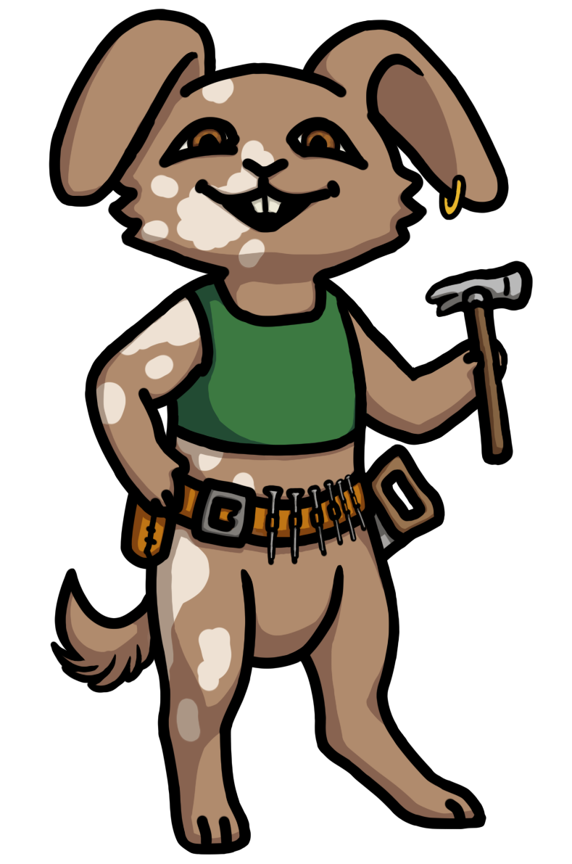
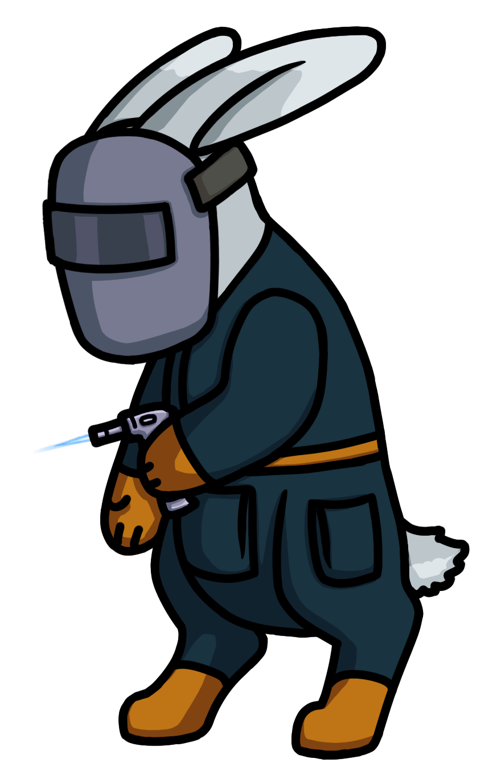
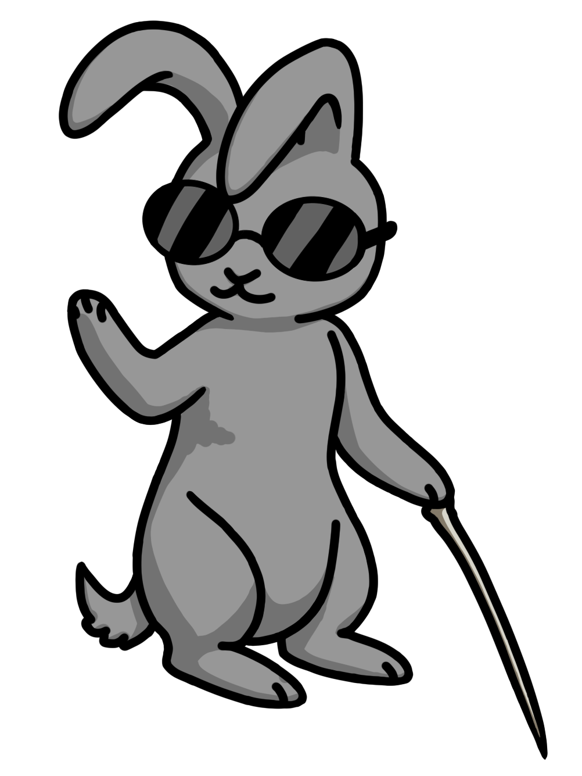

CHARACTERS
Upright, confident pose and smile shows Oakly’s cheerful and capable personality
Slightly turned away, a bit hunched. Shows Dewdrop’s more nervous personality.
Black outlines over cell shaded art
Bunnyville bunnies are friendly and look soft
A character’s idle pose should reflect their personality

Slide 5
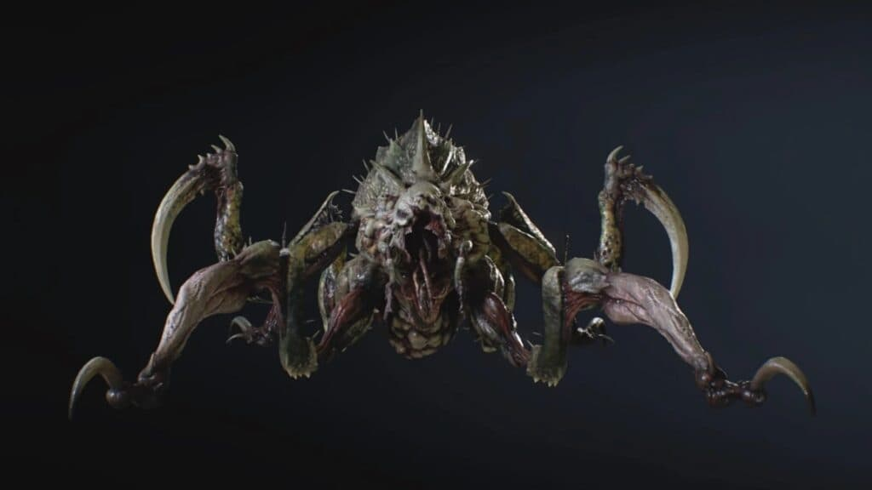
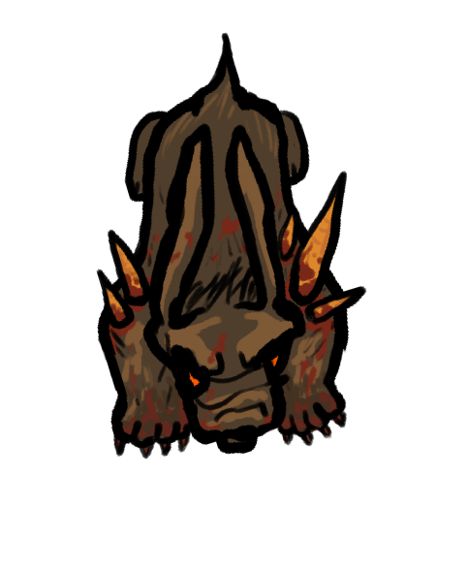
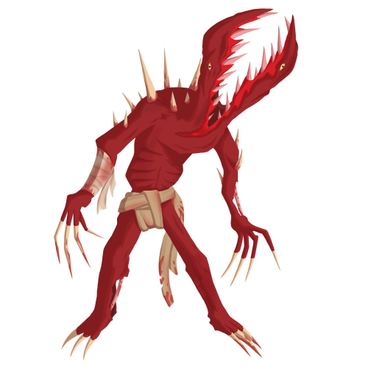
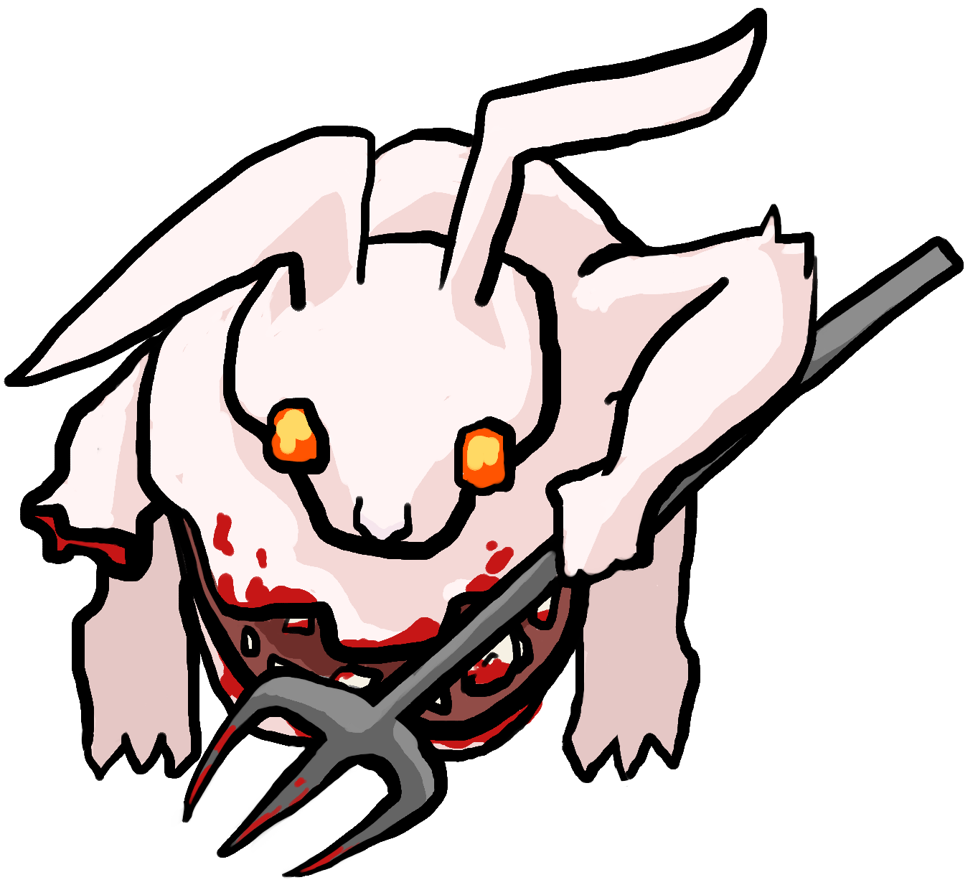
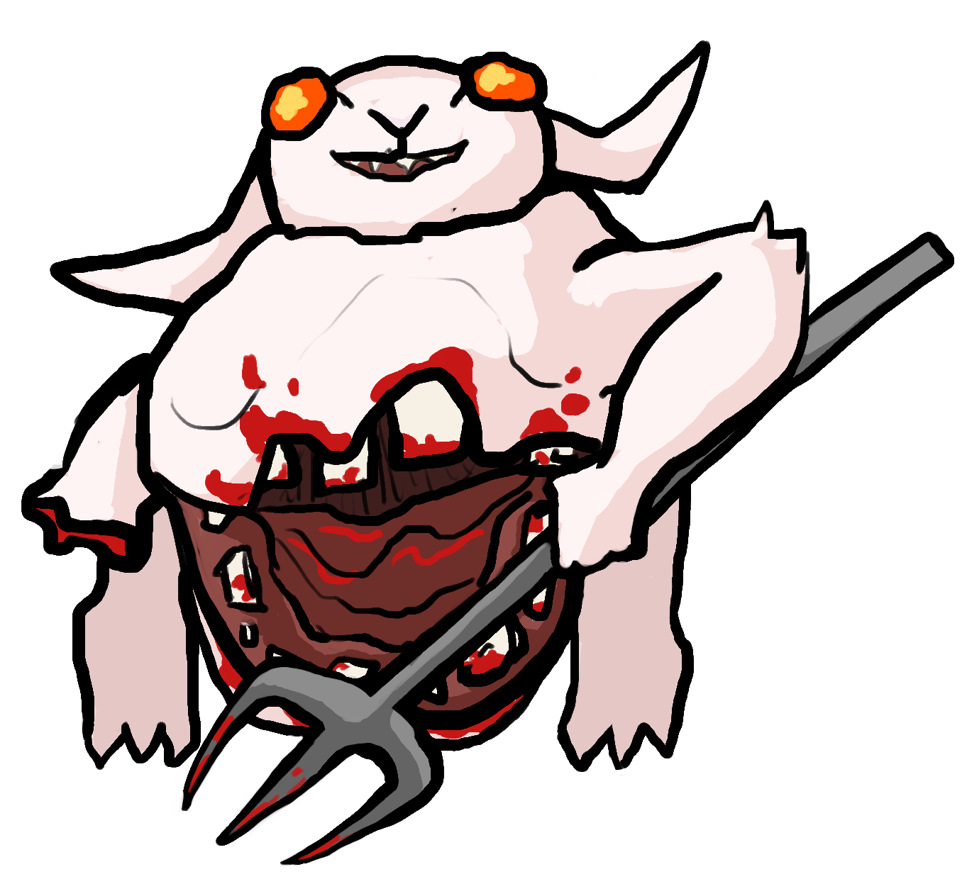
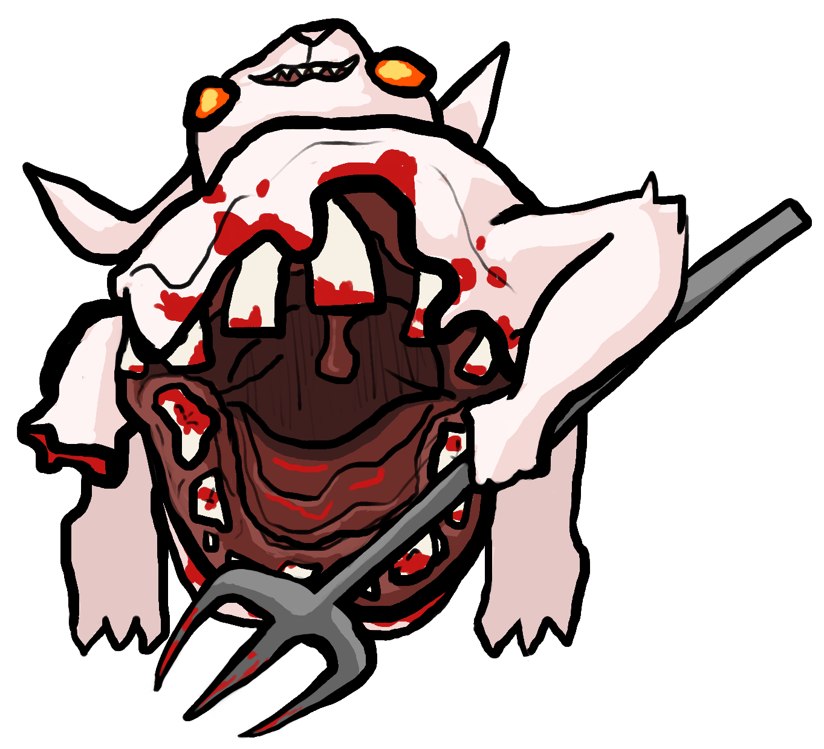
ENEMIES
Carrots growing out show the horror of the Carrot Curse
Black outlines over cell shaded art
Enemies mutated by the Carrot Curse are often zombie-like, with blood or warped bodies
Carrots often feature in the designs, as if they are growing through the cursed enemies
Enemies should have unique mutations reflecting their attack style and environment
Large mouth reflects massive melee attack style, and distinctive roar to summon allies

Slide 6
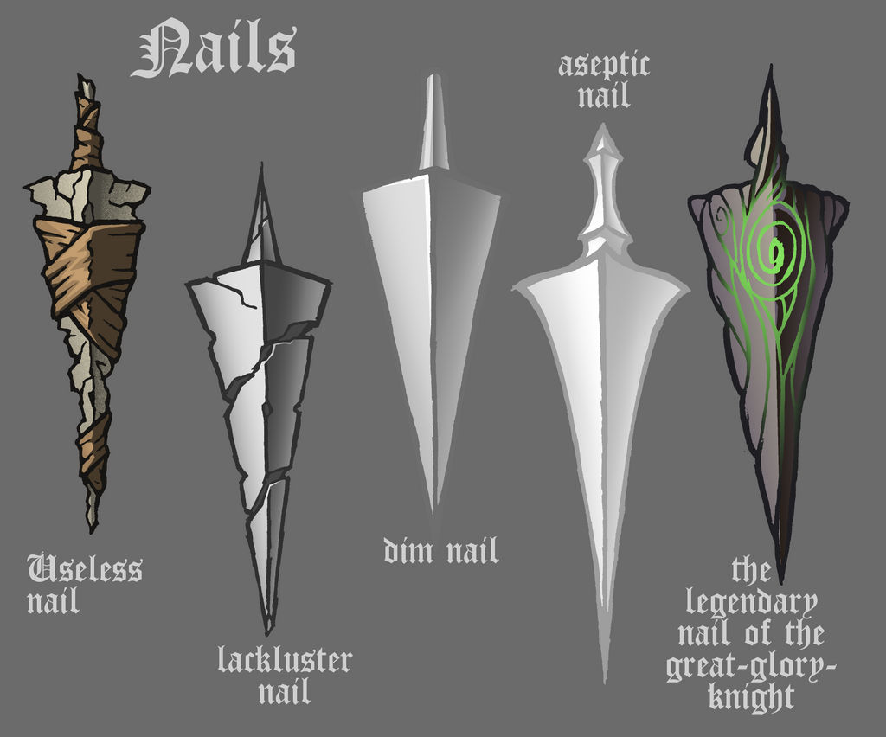

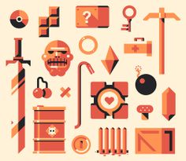
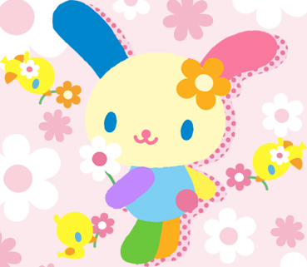
OBJECTS
Communicate the uniqueness of the item, while keeping the design simple
The currency, Carrot Seeds, is a simple rotating triangle
Other dropped items have black outlines and are cell-shaded, or have simple gradients
Items can either have a rough, sharp dreary style like the useless nail or they can be colorful and bright like you would find in Hello Kitty. Ignore the color palette.
Powerups will not be outlined, to better enhance their unique visuals

Slide 7
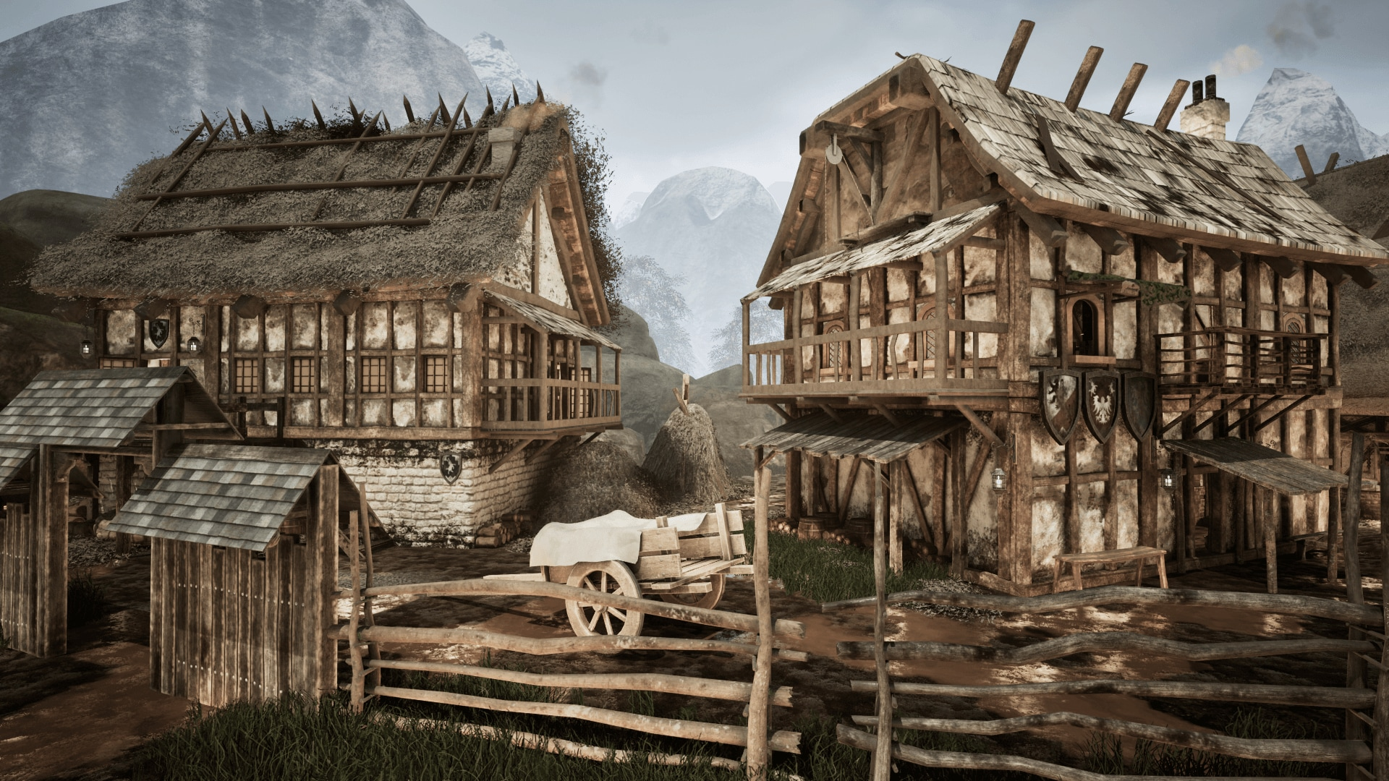
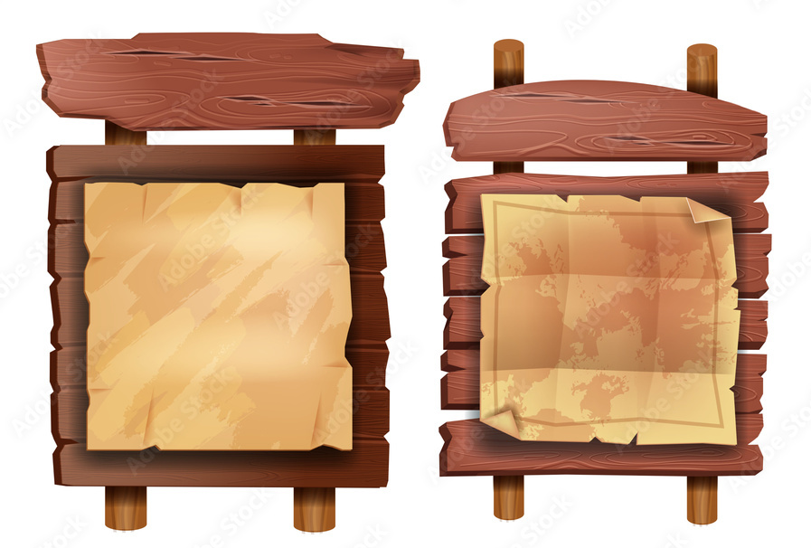
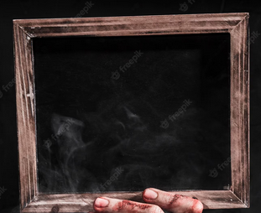
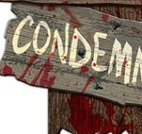
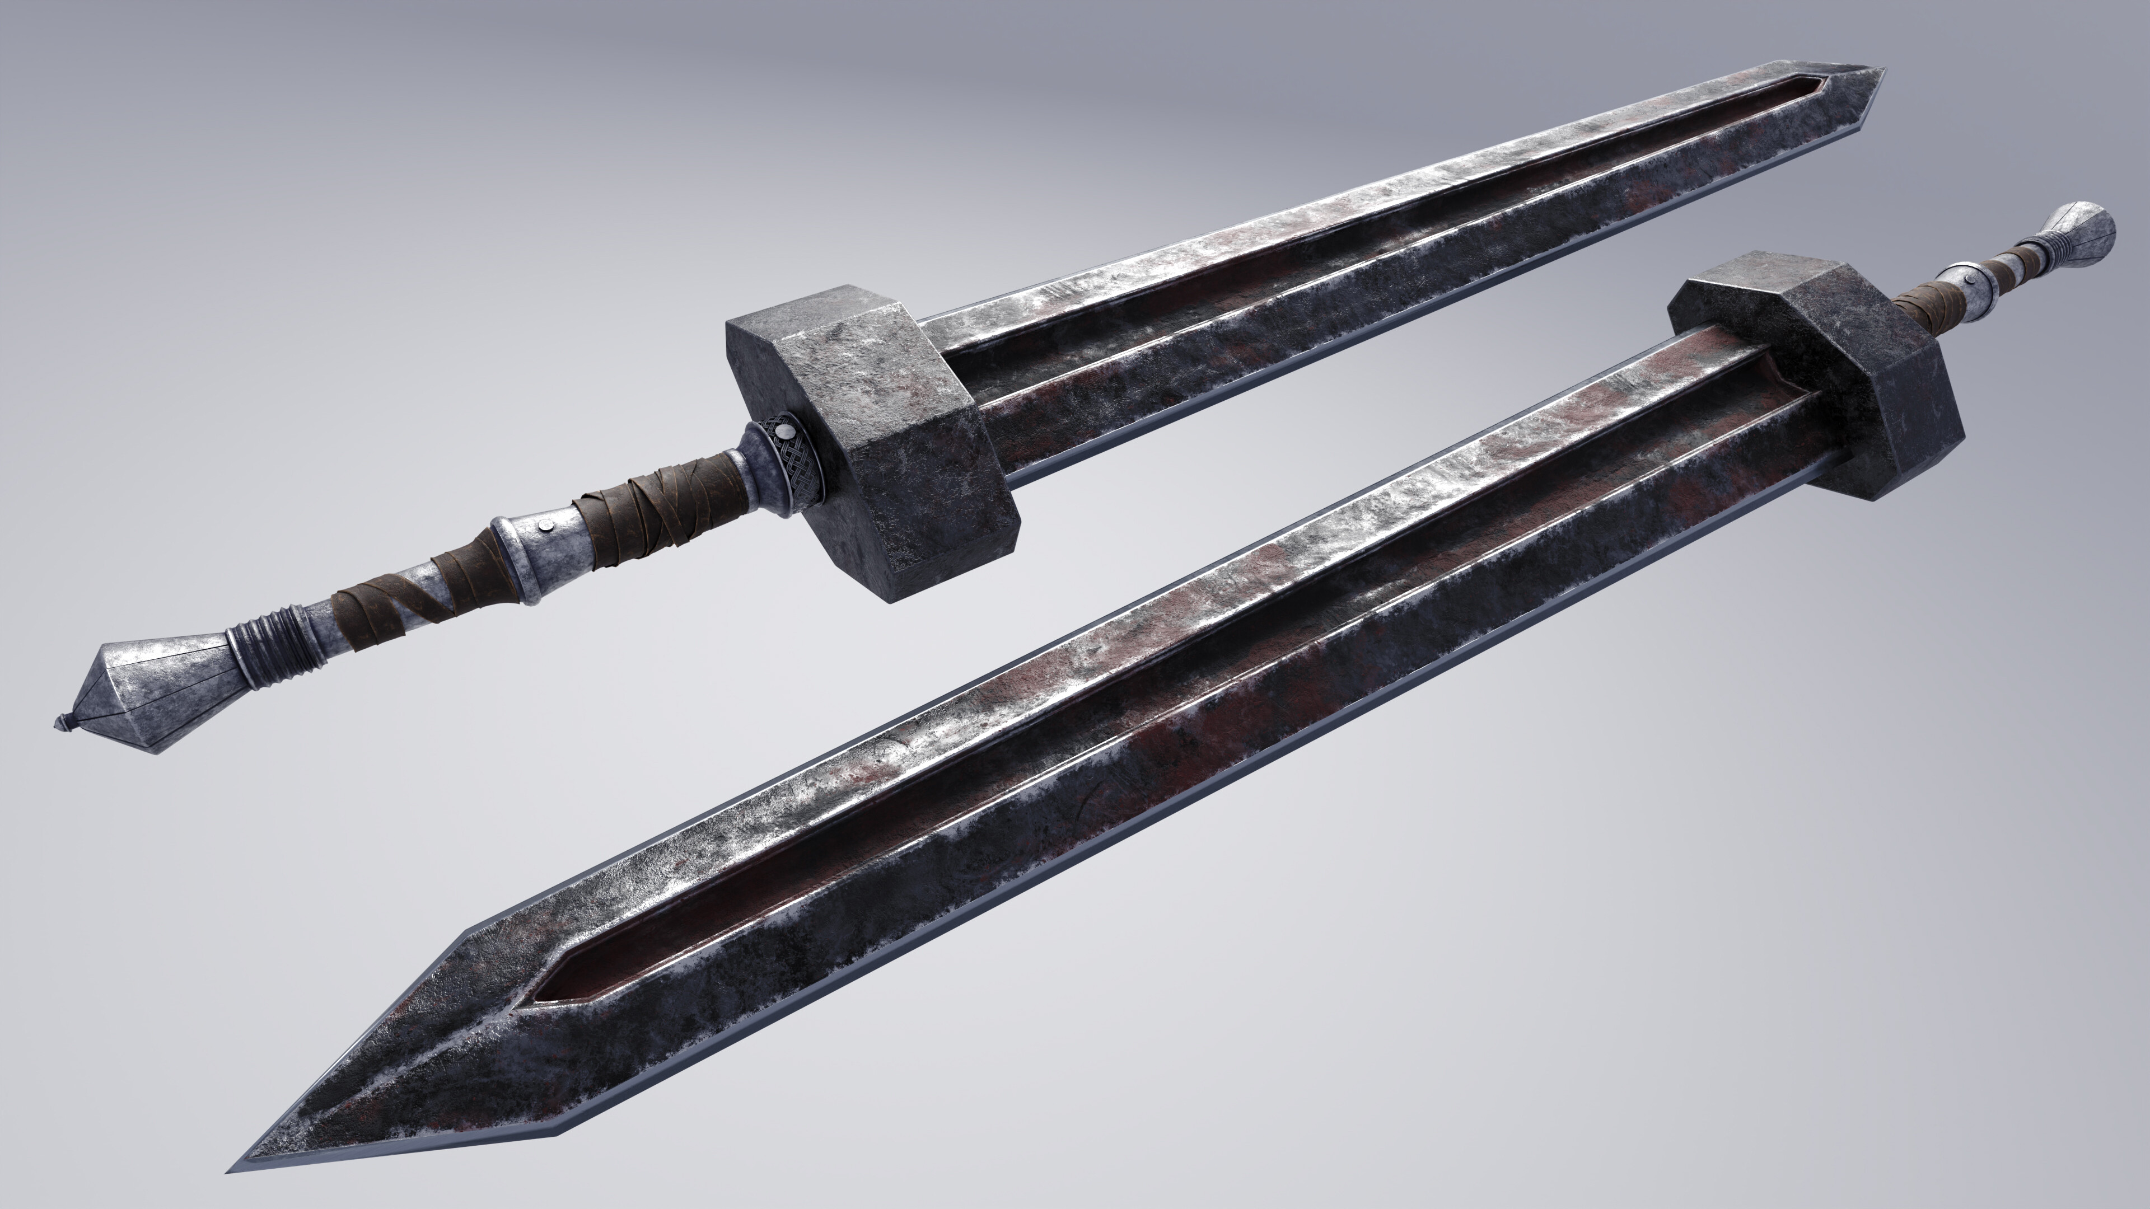
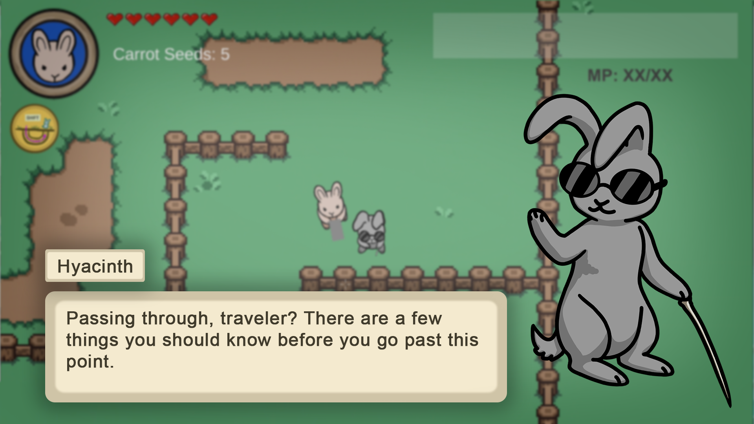
UI
Matching with the general aesthetics of the game, the UI will be outlined in black, or a dark brown
UI should feel “village rustic” with some rust and blood thrown in to show corruption. The blood will be subtle, on the corners, not overt as in the picture.

